Slide 1
Deep Learning Techniques
II M.Sc (DS / CS)

Slide 2
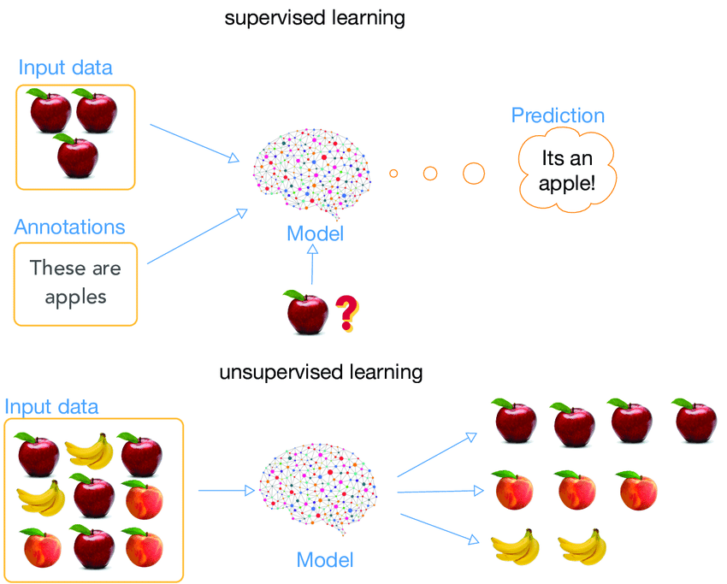
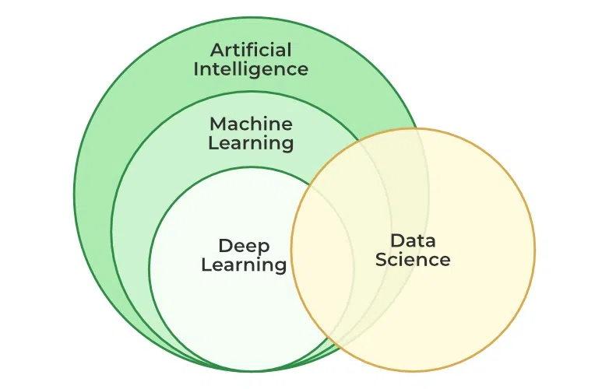
Introduction
Deep Learning is branch of machine learning based on Artificial Neural Networks
Machine learning is a branch of artificial intelligence (AI) and computer science which focuses on the use of data and algorithms to imitate the way that humans learn, gradually improving its accuracy.

Slide 3
Neural Networks
Day to day lives involves intelligence, pattern recognition and object detection which are challenging to automate.
How does a dog recognize its owner from a complete stranger?
How does a child identifies the difference between apple and an orange?
Answer lies with the biological neural networks present in our network system.
Artificial neural networks is a computation system attempts to mimic the neural connections in human nervous system.
Initially ANN was used to solve simple classification problem.
Now, due to increase in computation power, it can solve complex problems.

Slide 4
Basics of Neural Networks
Deep Learning is a sub field of ML that involves the use of neural networks to model and solve complex problems
NN : Biologically motivated approach to machine learning
Fundamental processing elements of a neural network is a neuron
1.Receives inputs from other source
2.Combines them in someway
3.Performs a generally nonlinear operation on the result
4.Outputs the final result

Slide 5
Similarity with Biological Network
Fundamental processing element of a neural network is a neuron
A human brain has 100 billion neurons

Slide 6
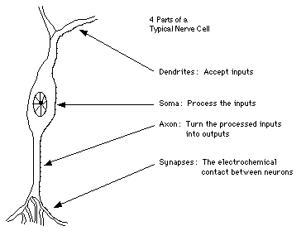
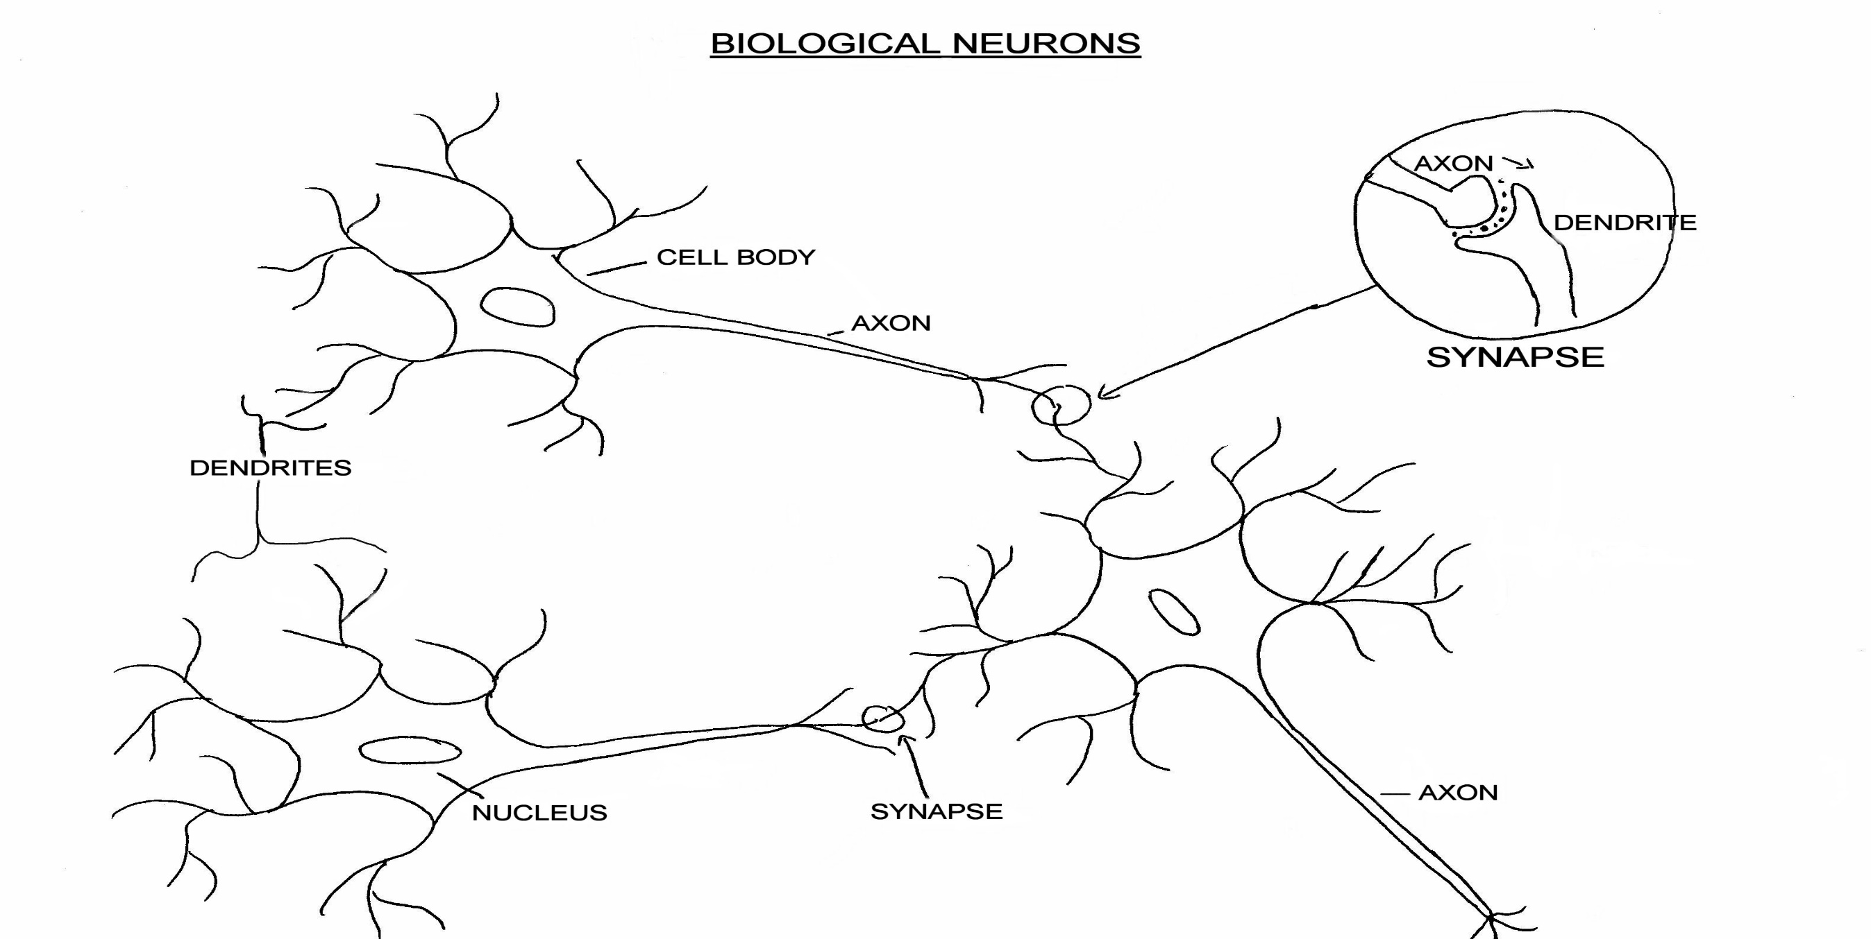

Slide 7
Artificial Neuron
W
Neuron
INPUTS
W
Σ
f(n)
Outputs
W
Activation
Function
W
W=Weight

Slide 8
NN
Artificial NN Artificial neural networks are built on the principles of the structure and operation of human neurons.
It is also known as neural networks or neural nets.
Neural Network is a set of connected INPUT/OUTPUT UNITS, where each connection has a WEIGHT associated with it.
An artificial neural network’s input layer, which is the first layer, receives input from external sources and passes it on to the hidden layer, which is the second layer.
Each neuron in the hidden layer gets information from the neurons in the previous layer, computes the weighted total, and then transfers it to the neurons in the next layer.
These connections are weighted, which means that the impacts of the inputs from the preceding layer are more or less optimized by giving each input a distinct weight.
These weights are then adjusted during the training process to enhance the performance of the model.

Slide 9
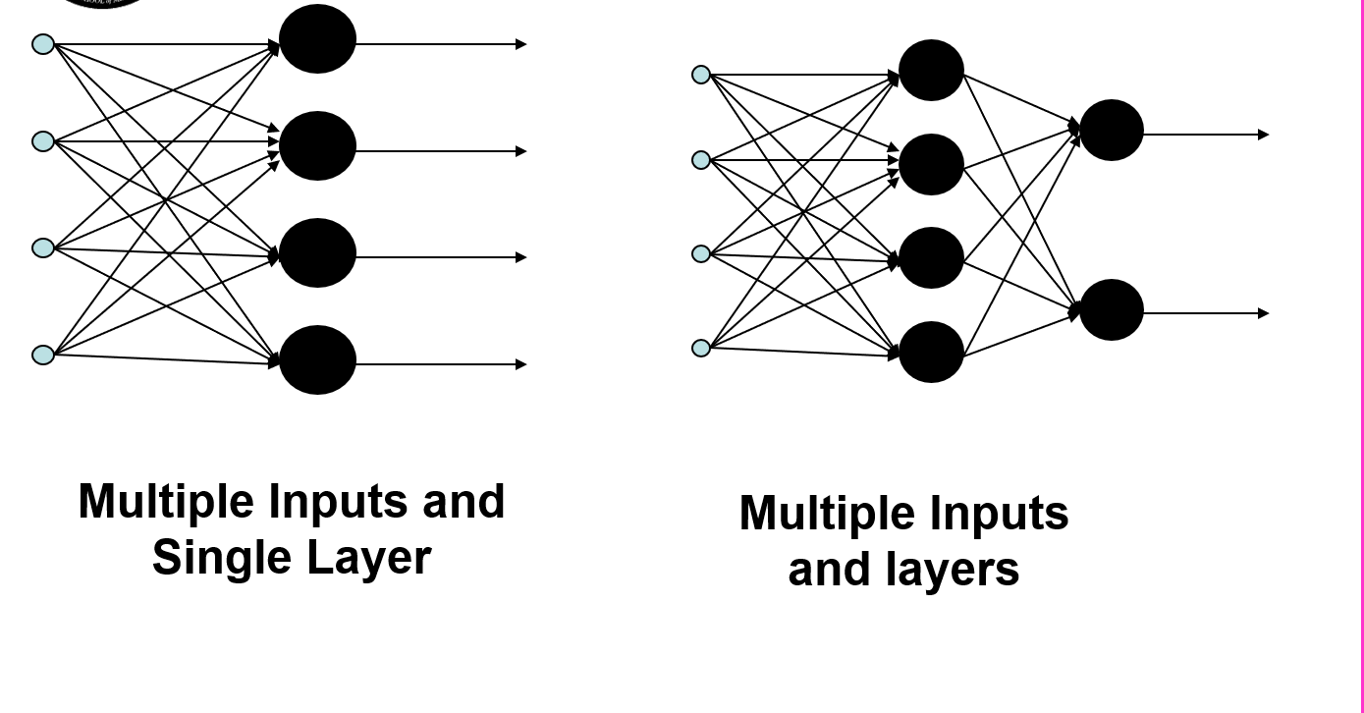
Types of Networks
NN learns more and more about the data as it moves from one unit to another, producing an output from the output layer.
The neural network learns more and more about the data as it moves from one unit to another, ultimately producing an output from the output layer.

Slide 10
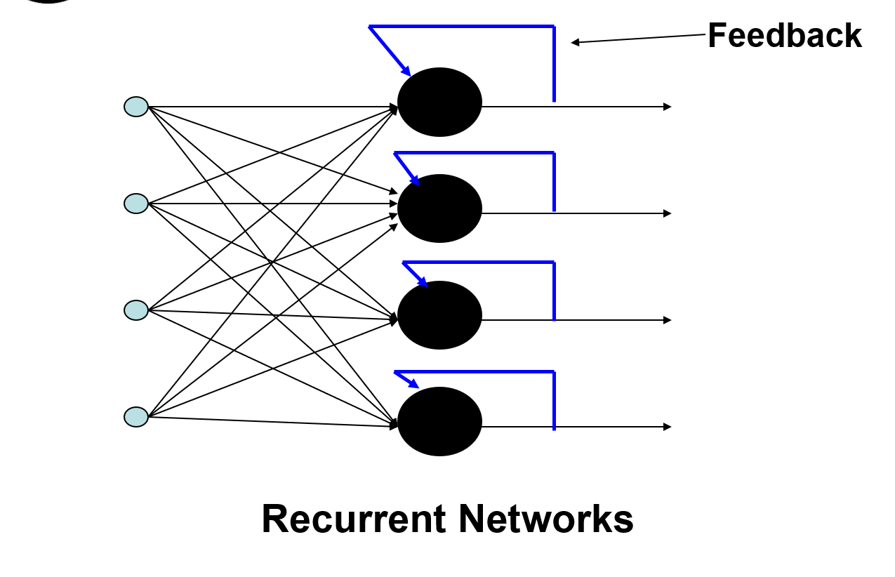
Cont..

Slide 11
Perceptrons
Inspired by the biological functioning of a neuron, an American scientist Franck Rosenblatt came up with the concept of perceptron at Cornell Aeronautical Laboratory in 1957.
A Perceptron is an Artificial Neuron
It is the simplest possible Neural Network
Scientists had discovered that brain cells (Neurons) receive input from our senses by electrical signals.
The Neurons, then again, use electrical signals to store information, and to make decisions based on previous input.

Slide 12
Main Components of Perceptron
Rosenblatt’s perceptron is basically a binary classifier. The perceptron consists of 3 main parts:
Input nodes or input layer: The input layer takes the initial data into the system for further processing. Each input node is associated with a numerical value. It can take any real value.
Weights and bias: Weight parameters represent the strength of the connection between units. Higher is the weight, stronger is the influence of the associated input neuron to decide the output. Bias plays the same as the intercept in a linear equation.
Activation function: The activation function determines whether the neuron will fire or not. At its simplest, the activation function is a step function, but based on the scenario, different activation functions can be used.

Slide 13
Working of Perceptron
First Step :
All input values are multiplied with their respective weights and added together
The result obtained is called weighted sum ∑wi*xi, or it is stated as x1*w1 + x2*w2 +…wn*xn.
This sum gives appropriate representation of the inputs based on their importance.
Additionally a bias term b is added to this sum ∑wi*xi + b
Bias serves as another model parameter (in addition to weights) that can be tuned to improve the model’s performance.

Slide 14
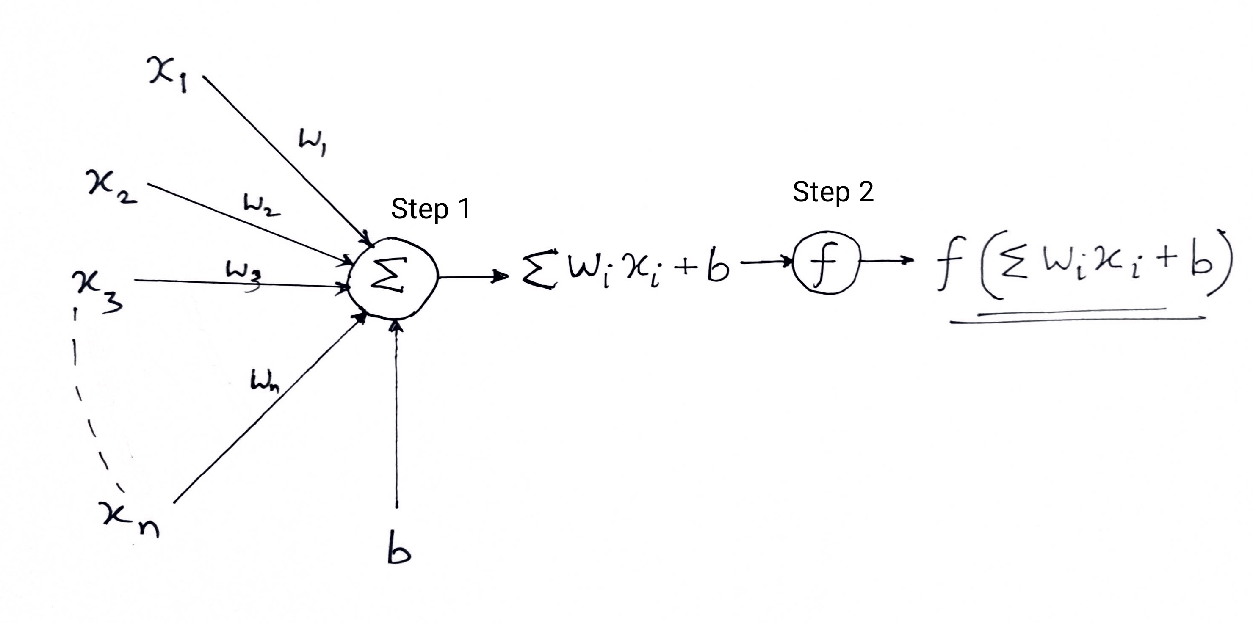
Cont..
Second Step :
A activation function f is applied over the above sum ∑wi*xi + b to obtain output Y = f(∑wi*xi + b).
Depending upon the scenario and the activation function used, the Output is either binary {1, 0} or a continuous value.

Slide 15
Cont..
Frank had the idea that Perceptrons could simulate brain principles, with the ability to learn and make decisions.
The original Perceptron was designed to take a number of binary inputs, and produce one binary output (0 or 1).
The idea was to use different weights to represent the importance of each input, and that the sum of the values should be greater than a threshold value before making a decision like yes or no (true or false) (0 or 1).

Slide 16

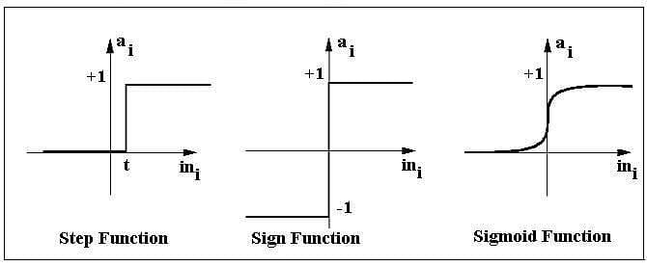
Activation Functions
The artificial neuron will fire when the sum of the inputs (weighted sum) exceeds a certain threshold value, let’s say 0
Perceptron is a function that maps its input x which is multiplied with learned weight coefficient ; an output value f(x) is generated
The output can be 1 or 0 . It can be 1 or -1 depending on the activation function.

Slide 17
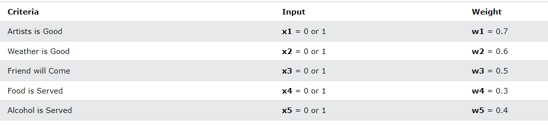
Perceptron Example
Imagine a perceptron (in your brain).
The perceptron tries to decide if you should go to a concert.
Is the artist good? Is the weather good?
What weights should these facts have?

Slide 18
The Perceptron Algorithm
Frank Rosenblatt suggested this algorithm:
Set a threshold value
Multiply all inputs with its weights
Sum all the results
Activate the output
1. Set a threshold value: Threshold = 1.5
2. Multiply all inputs with its weights:
x1 * w1 = 1 * 0.7 = 0.7
x2 * w2 = 0 * 0.6 = 0
x3 * w3 = 1 * 0.5 = 0.5
x4 * w4 = 0 * 0.3 = 0
x5 * w5 = 1 * 0.4 = 0.4
3. Sum all the results: 0.7 + 0 + 0.5 + 0 + 0.4 = 1.6 (The Weighted Sum)
4. Activate the Output: Return true if the sum > 1.5 ("Yes I will go to the Concert")

Slide 19
Feed Forward Networks
The neural network needs that extra information to efficiently propagate forward.
Feed-Forward Neural Network is a single layer perceptron.
A sequence of inputs enter the layer and are multiplied by the weights in this model
The weighted input values are then summed together to form a total.
If the sum of the values is more than a predetermined threshold, which is normally set at zero, the output value is usually 1,
if the sum is less than the threshold, the output value is usually -1.
The single-layer perceptron is a popular feed-forward neural network model that is frequently used for classification.
Weights set the standards for the neuron's signal strength. This value will determine the influence input data has on the output product.
Biases give extra characteristics with a value of 1 that the neural network did not previously have.

Slide 20
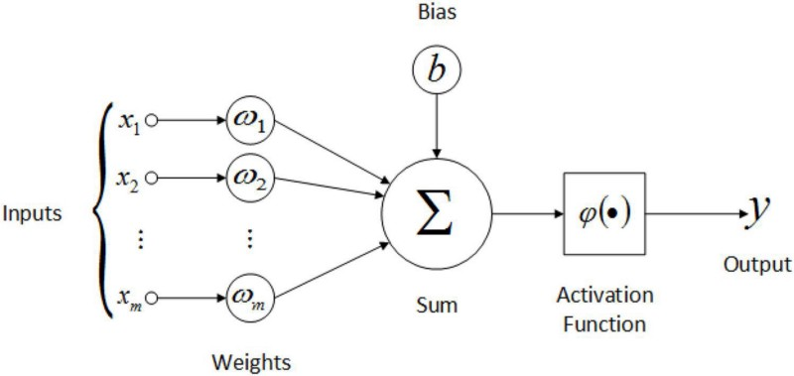

Slide 21
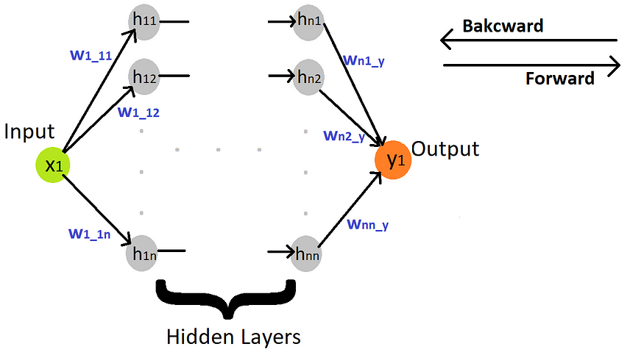
Forward feed in an example neural network structure

Slide 22
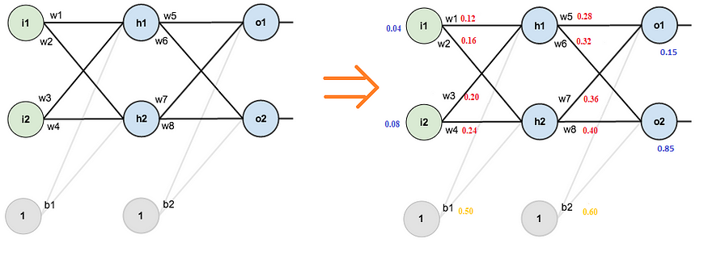
Example
There are two input neurons (node), two hidden neurons, and two output neurons. In addition to these, the hidden layer and the output layer contain two biases.
“sigmoid” activation function is used in the hidden layer.
i is abbreviated to represent the input layer
h is abbreviated to represent the hidden layer
o is abbreviated to represent the output layer.

Slide 23

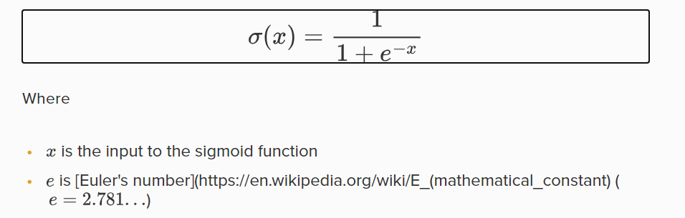
Cont..
Finding h1
H1 -

Slide 24

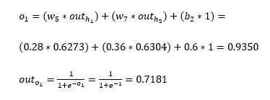
Cont..
Finding h2
Since hidden layer is over , Finding output layer
O1

Slide 25
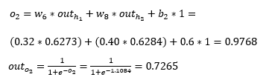
Cont..
O2

Slide 26
Intro – Back Propagation
Backpropagation is a supervised learning algorithm, for training Multi-layer Perceptrons (Artificial Neural Networks).
it’s not necessary that whatever weight values we have selected will be correct, or it fits our model the best.
We have selected some weight values in the beginning, but our model output is way different than our actual output i.e. the error value is huge.
how will you reduce the error?
Basically, what we need to do, we need to somehow explain the model to change the parameters (weights), such that error becomes minimum.
Let’s put it in an another way, we need to train our model.
One way to train our model is called as Backpropagation. Consider the diagram below:

Slide 27
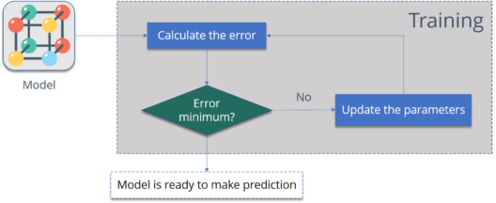
Cont..
Summary :
Calculate the error – How far is your model output from the actual output.
Minimum Error – Check whether the error is minimized or not.
Update the parameters – If the error is huge then, update the parameters (weights and biases). After that again check the error. Repeat the process until the error becomes minimum.
Model is ready to make a prediction – Once the error becomes minimum, you can feed some inputs to your model and it will produce the output.

Slide 28
Back Propagation NN
BP is the process involved in training NN
It takes the error rate of forward propagation and feeding this loss backward through NN layers to fine tune the weights.
BP is an essence of Neural Net Training
It is the practice of fine-tuning the weights of a neural net based on the error rate (i.e. loss) obtained in the previous epoch (i.e. iteration.)
The Backpropagation algorithm looks for the minimum value of the error function in weight space using a technique called the delta rule or gradient descent. The weights that minimize the error function is then considered to be a solution to the learning problem.

Slide 29
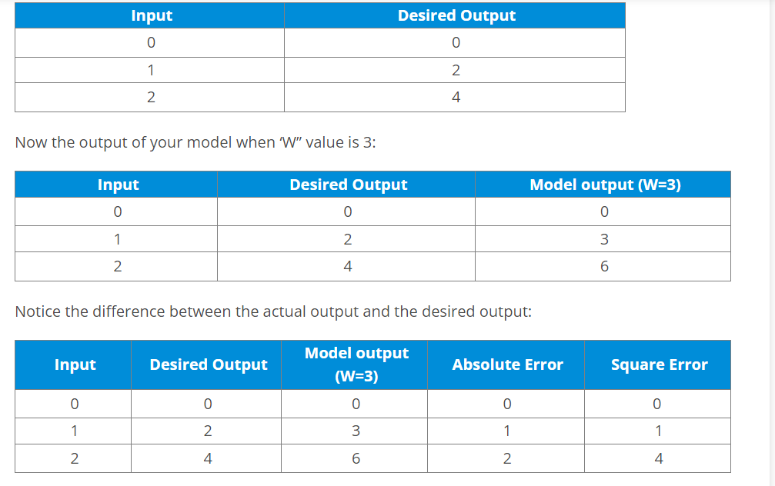
Example

Slide 30
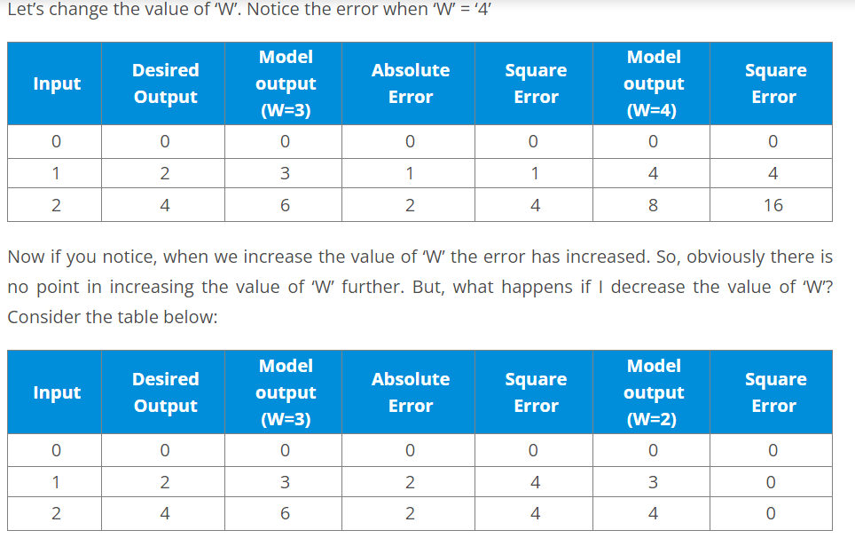
Example Cont..

Slide 31
Cont..
We first initialized some random value to ‘W’ and propagated forward.
Then, we noticed that there is some error. To reduce that error, we propagated backwards and increased the value of ‘W’.
After that, also we noticed that the error has increased. We came to know that, we can’t increase the ‘W’ value.
So, we again propagated backwards and we decreased ‘W’ value.
Now, we noticed that the error has reduced.

Slide 32
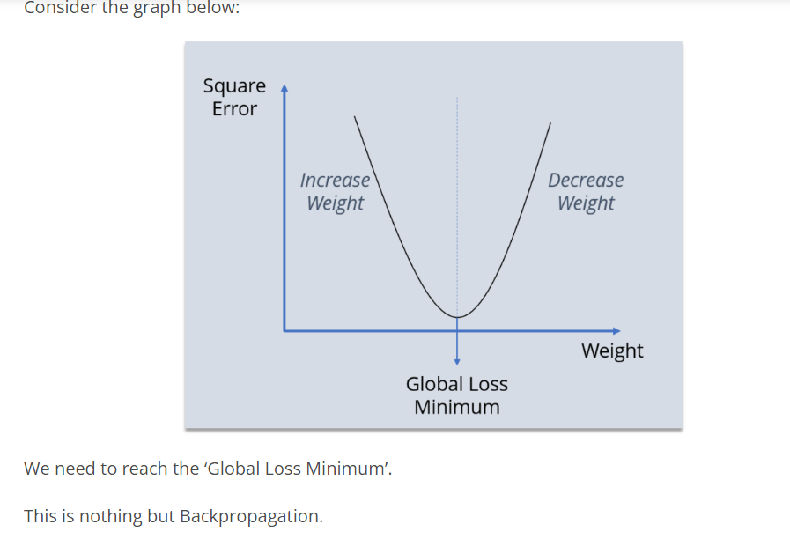
Cont..

Slide 33
https://www.bogotobogo.com/python/scikit-learn/Artificial-Neural-Network-ANN-4-Backpropagation.php

Slide 34
References
https://www.geeksforgeeks.org/single-layer-perceptron-in-tensorflow/?ref=lbp
https://www.w3schools.com/ai/ai_perceptrons.asp
https://www.simplilearn.com/tutorials/deep-learning-tutorial/perceptron
https://www.simplilearn.com/tutorials/deep-learning-tutorial/multilayer-perceptron#forward_propagation
https://medium.com/deeper-deep-learning-tr/ad%C4%B1m-ad%C4%B1m-forward-and-back-propagation-cf4cd18276ee
https://www.edureka.co/blog/backpropagation/
https://builtin.com/machine-learning/backpropagation-neural-network

